Slide 1

Case Study:Practical 1&2
MACHINE LEARNING LAB
CSF-334
Submitted by:
Shubhnoor Gill
18BCS6061
B.E CSE(AIML-1)
Group B

Slide 2

ABSTRACT
In this case study we are given with cancer_mortality dataset. Our goal is to predict cancer mortality rates for US countries.
In order to achieve our goal, we need to build a multivariate Ordinary Least Squares regression model to predict “ TARGET_deathRate” as per the given instructions.
Goal: To predict cancer mortality rates for US countries
Target variable: TARGET_deathRate

Slide 3
Problem Solving Methodology
START
END
Load cancer_mortality dataset
Use Recursive Feature Elimination
Build OLS regression model
Check RMSE
Drop variable
Model Evaluation on test set (Plot actual vs predicted values)
Data Understanding and Visualization
Divide train dataset into X_train, y_train
Working on test dataset
If variable has VIF<5 and p-value <0.05
No
Data Cleaning and Data Transformation
Scale the train data
Make predictions
Using model built
Yes
Create dummy variables and prepare data
Split data into train and test
Make predictions and check RMSE
Residual Analysis
Model Building(working on train dataset)

Slide 4
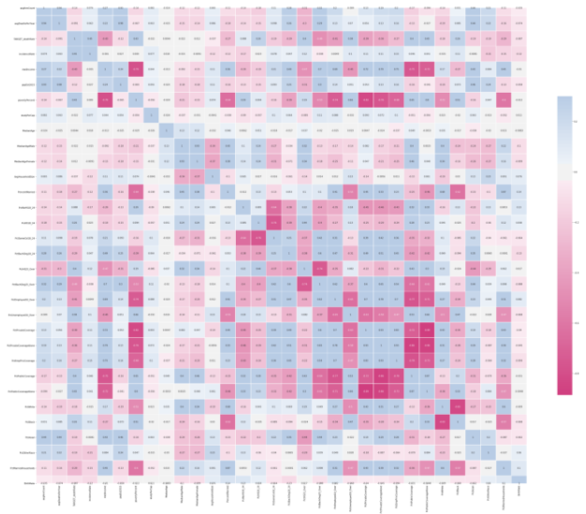
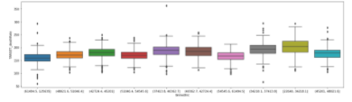
Analysis
1. Data Understanding and Visualization:
Data set has 34 columns and 3047 rows.
It has 2 categorical variables: binnedInc, Geography
Presence of 3 columns with null values, which are: “PctSomeCol18_24”, “PctEmployed16_Over”, “PctPrivateCoverageAlone”.
We can see from the Fig2: heatmap that the boxes shaded with: => Dark pink color have high negative correlation => Blue color have positive correlation We can observe that multicollinearity also exists.
Fig2: Heatmap of correlation matrix
Fig1: Boxplots showing different categories in ‘binnedInc’.

Slide 5
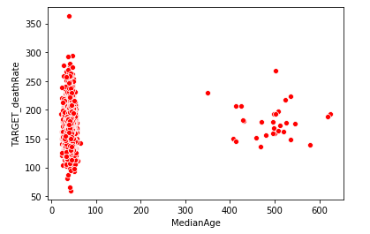
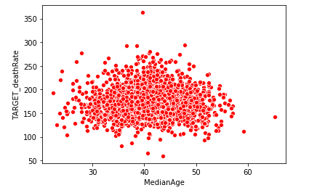
Analysis (cont.…)
2. Data Cleaning Analysis:
“PctSomeCol18_24” has about 75% of missing values, hence we prefer to drop this column.
“PctEmployed16_Over”, “PctPrivateCoverageAlone” have less than 20% of missing values, which we replace with their mean values.
The “MedianAge” has many outliers as seen in Fig3. A person cannot survive for 300 years or above. As, the “MedianAge” is the average of “MedianAgeMale” and “MedianAgeFemale”. The maximum value of MedianAgeMale and MedianAgeFemale is 64.7 and 65.7 respectively. So, the maximum MedianAge can be 65.3. So, we replace the indices where outliers i.e. MedianAge are greater than 65.3
Fig3: Scatterplot of MedianAge
( Shows many outliers)
Fig4: Scatterplot of MedianAge
( After treating outliers)

Slide 6
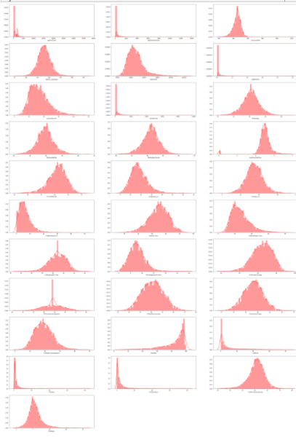
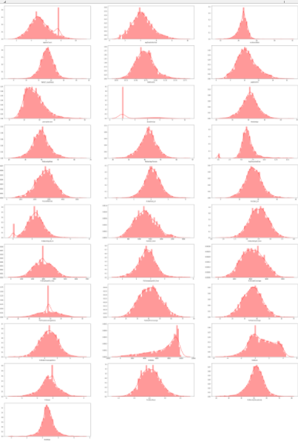
Analysis (cont.…)
3. Data Transformation and IQR Analysis
We see that our data is highly skewed in Fig4. According to one of the assumption for regression, the data should be normally distributed. Hence we reduce the skewness by applying log, square root, cube root and square transformations.
Moreover, we identify and treat outliers in our dataset using IQR (Inter Quartile Range) method. After applying this, we are left with 2880 rows.
Fig4: Distplots of numerical variables showing high skewness.
Fig5: Distplots of numerical variables showing low skewness after data transformation.

Slide 7
Analysis (cont.…)
4. Model Building Analysis:
Data is split into training(70%) and testing(30%).
We scale our data using Min-Max scaler, this helps to rescale the variables so that they have a comparable scale.
We use Recursive Feature Elimination(RFE) technique to find the best features.
The 16 best features according to RFE are: 'avgAnnCount', 'avgDeathsPerYear', 'incidenceRate', 'medIncome', 'popEst2015', 'povertyPercent', 'MedianAgeFemale', 'PercentMarried', 'PctHS18_24', 'PctBachDeg25_Over', 'PctUnemployed16_Over', 'PctPrivateCoverage', 'PctPublicCoverage', 'PctPublicCoverageAlone', 'PctOtherRace', 'PctMarriedHouseholds‘
We use these features to build OLS regression model. We check Variance Inflation Factor(VIF), p-values, Adjusted R².
We drop features with VIF >5 and p-values>0.05. As high VIF indicates presence of multicollinearity and high p-values indicate that the feature is insignificant.

Slide 8
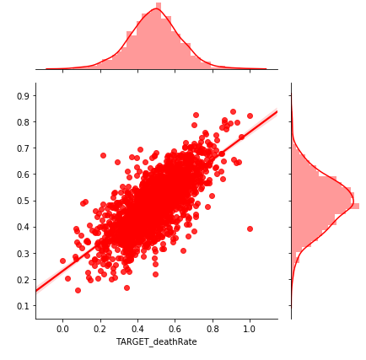
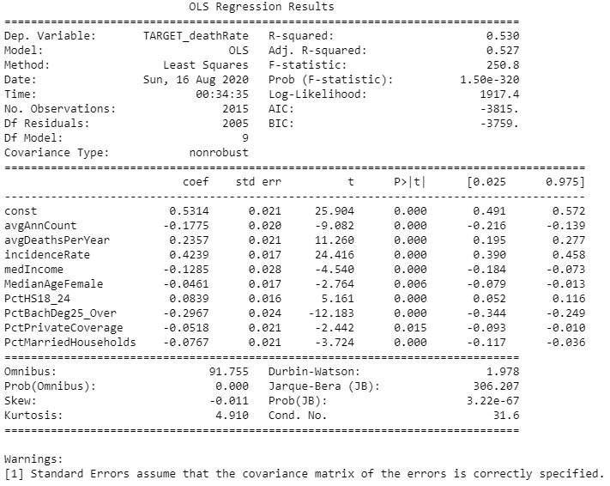
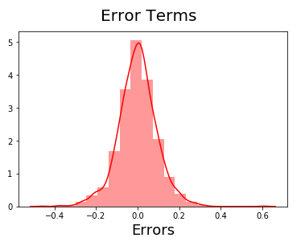
Analysis of Final OLS Regression Model
Achieved a R² value of 0.530
Error is minimum, RMSE is approx. 0.1
Fig7 shows a good linear relationship between the actual values and values predicted by final model.
Fig8 shows the residual analysis. This shows that errors are normally distributed. Hence, satisfying the assumption of regression.
Fig7: Joint plot(actual vs predicted)
Fig6: Summary of final model
Fig8: Residual Analysis

Slide 9
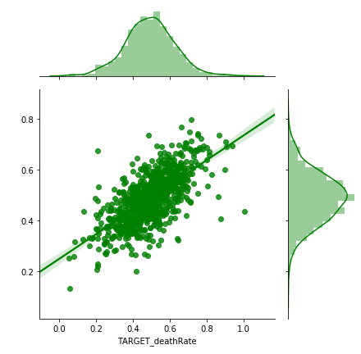
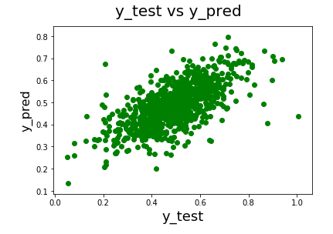
Result: Model Prediction Analysis
Fig9 and Fig10 shows a good linear relationship between the actual values and values predicted by final model on testing dataset.
Also, we have achieved a RMSE value of approx. 0.1, which is same as that of training set. Hence, we can say that it is a good model.
Fig9: Scatterplot(actual vs predicted values)
Fig10: Joint plot(actual vs predicted values)
The equation of our best fit hyperplane is:
TARGET_deathRate = 0.531 + 0.236 x avgDeathsPerYear - 0.177 x avgAnnCount + 0.424 x incidenceRate - 0.129 x medIncome - 0.046 x MedianAgeFemale + 0.084 x PctHS18_24 - 0.297 x PctBachDeg25_Over - 0.052 x PctPrivateCoverage - 0.077 x PctMarriedHouseholds

Slide 10
Further Improvements
Overall we have a decent model, but we also acknowledge that we could do better.
We have a couple of options:
Clean data deeply and handle outliers more effectively.
Try combinations of more new features.
Build a non-linear model.

Slide 11
THANK YOU
Please give your valuable feedback.

